Slide 1
Go To Meetings
Roman Catholic Diocese of Lexington

Slide 2
Who can set up a meeting through “Go To Meetings”
All users (Churches and Schools) that have a Go To Connect Extension will be able to set up and host a meeting.
Others, that do not have Go To Connect Extension Phone Service, will be able to receive an invitation to join the meeting only.

Slide 3
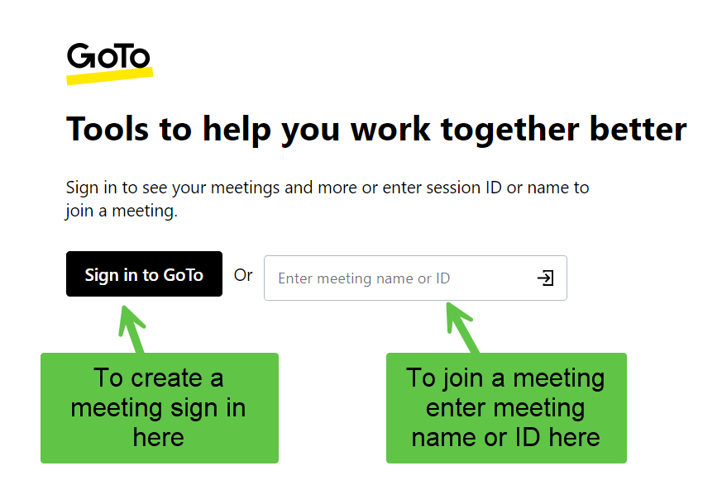
How do I create a meeting in GoTo with the desktop app?
You can access a web version by going to https://app.goto.com
Please note, the login name is your email address. If you do not remember your password, you will be given the option to reset it.

Slide 4
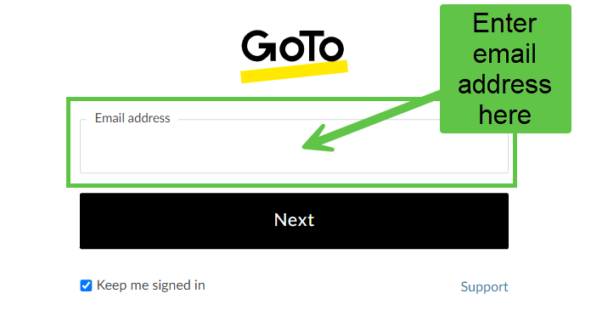
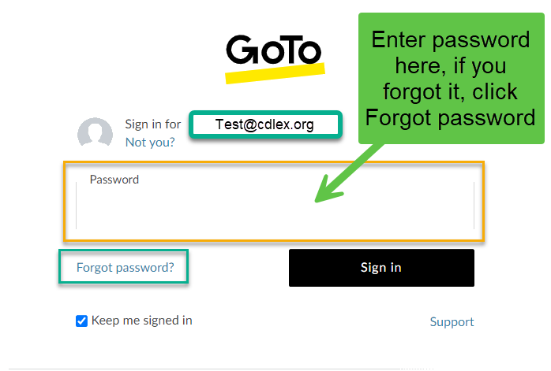

Slide 5
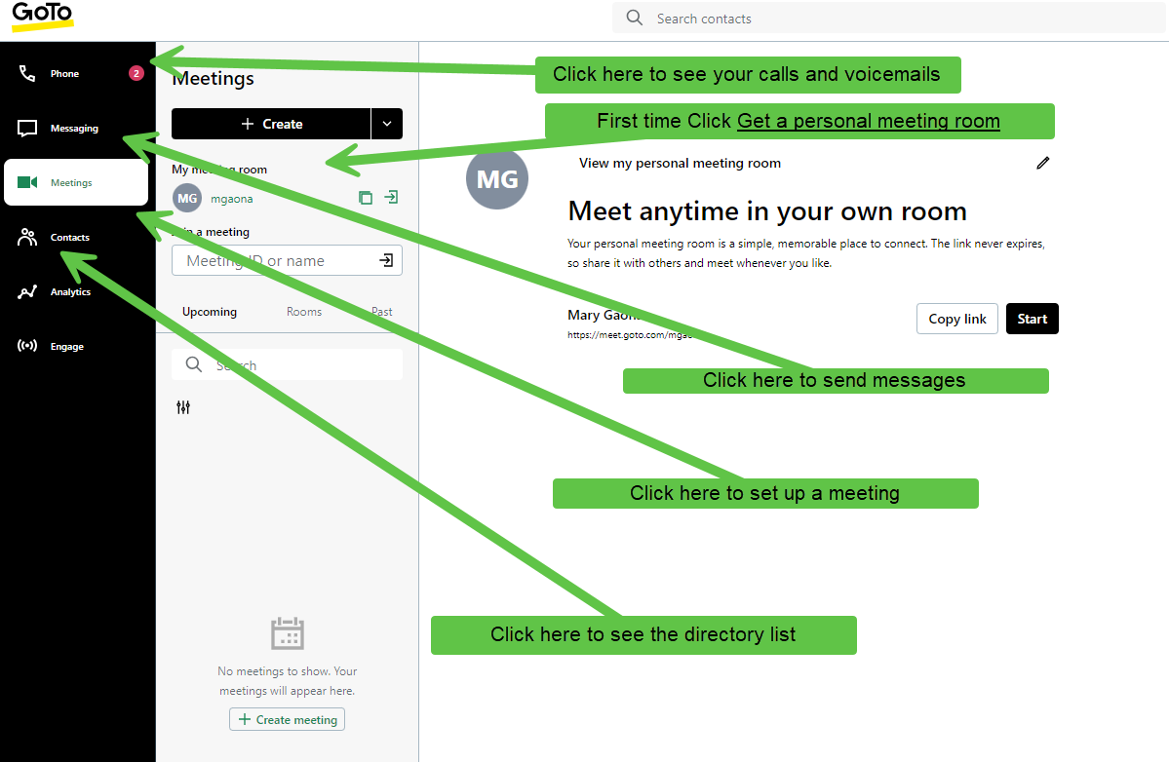
After accepting the terms, you will be able to access GoTo Connect

Slide 6
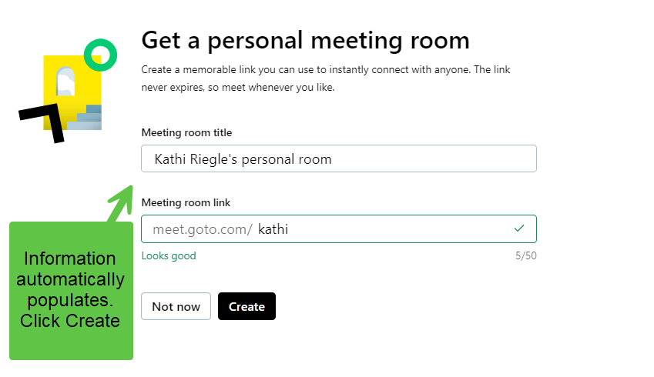
Create your own personal meeting room.

Slide 7
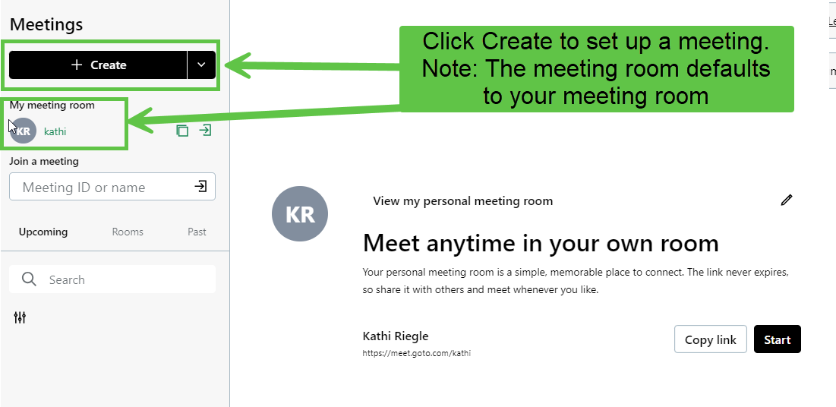

Slide 8
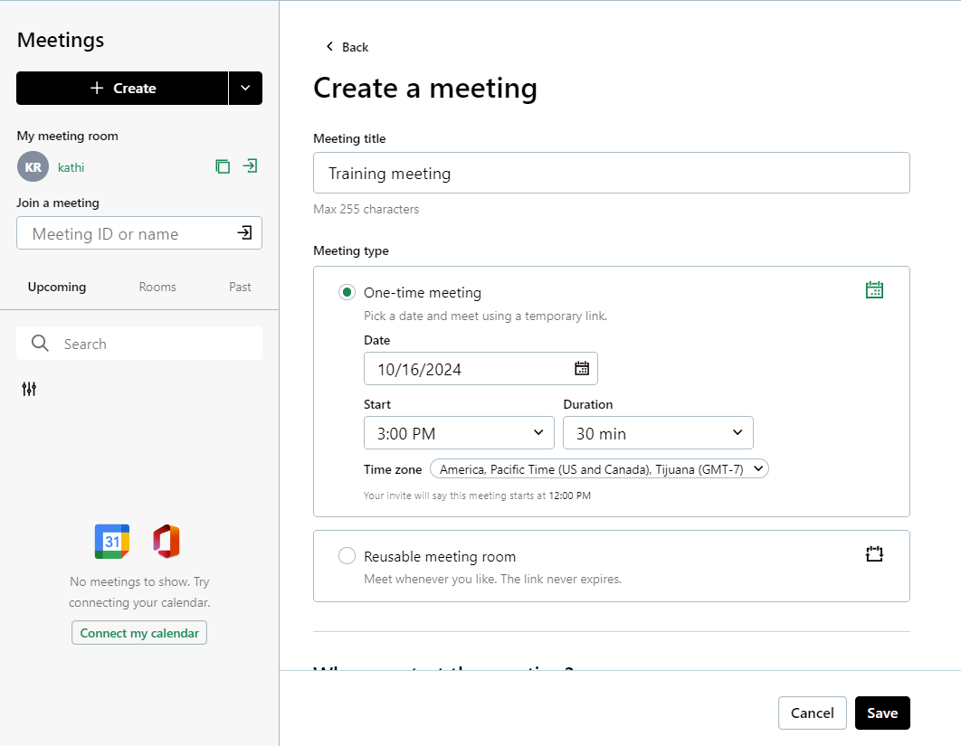
Populate the meeting information and click save

Slide 9
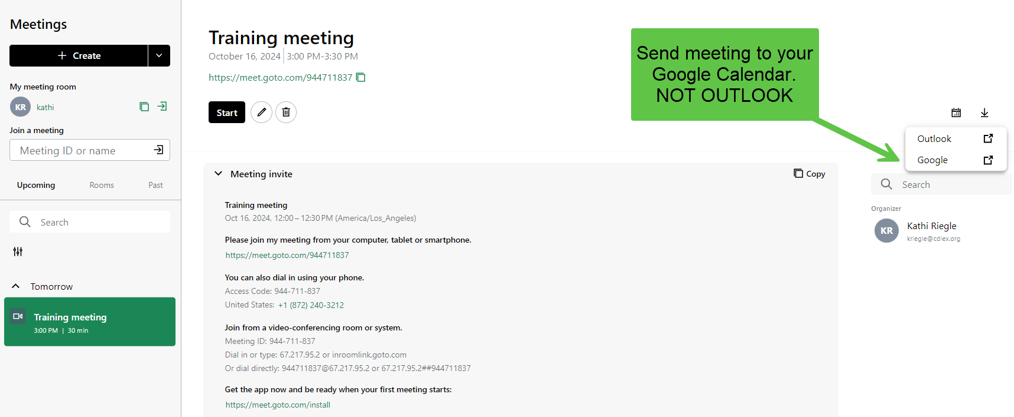

Slide 10
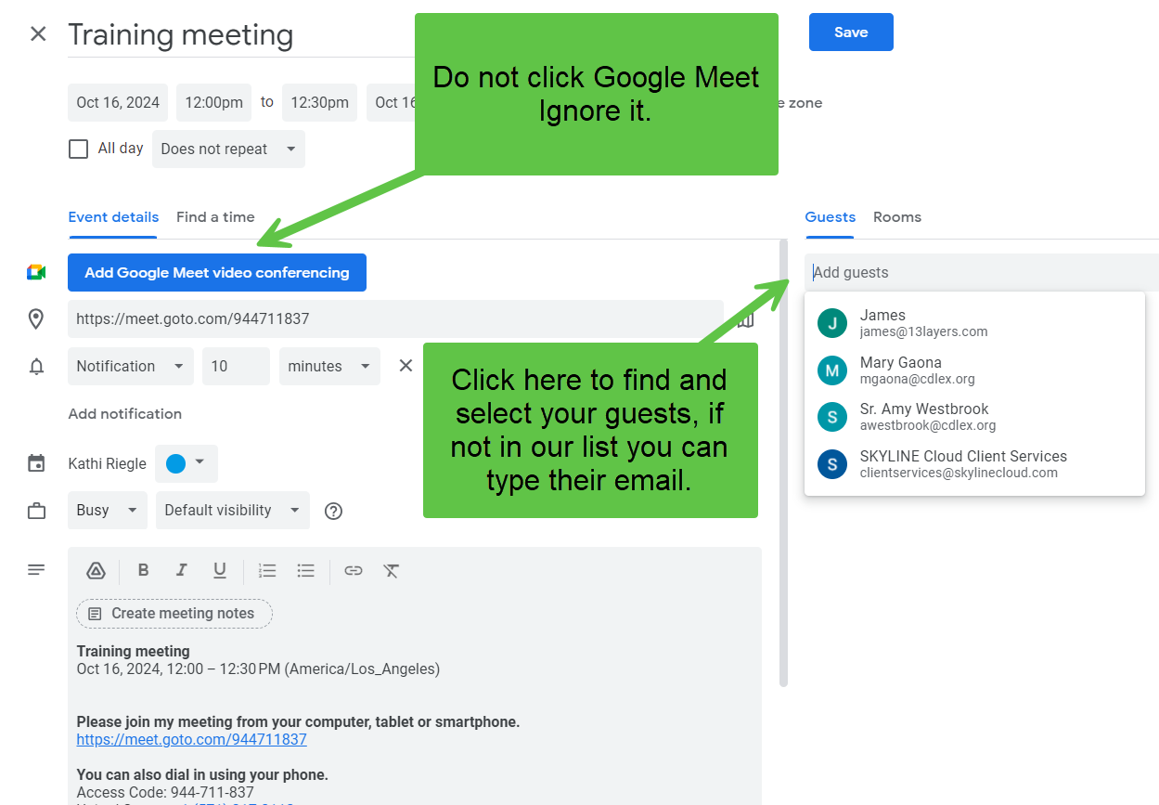
Once you have selected your guests click save.

Slide 11
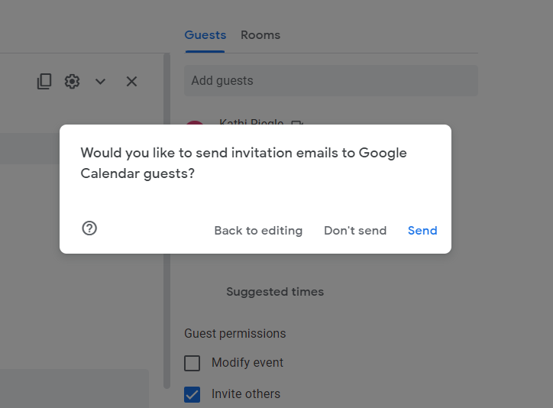
Click Send to email your invitation to selected guests.

Slide 12
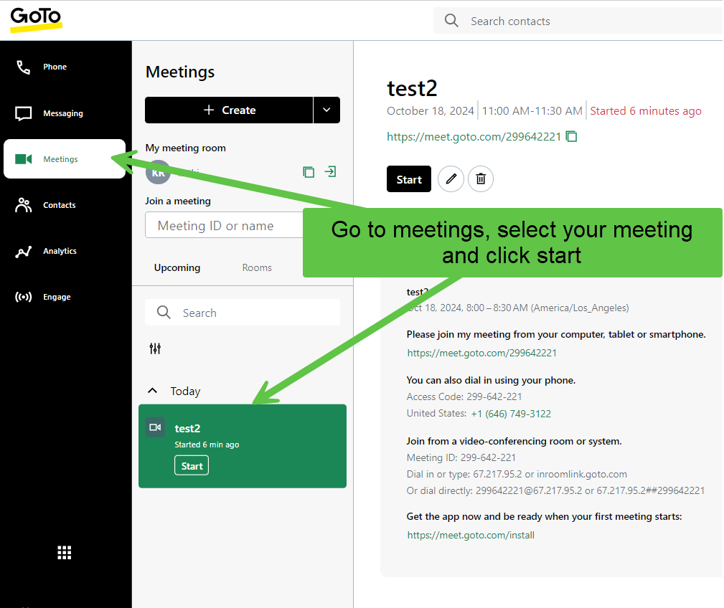
To start the meeting

Slide 13
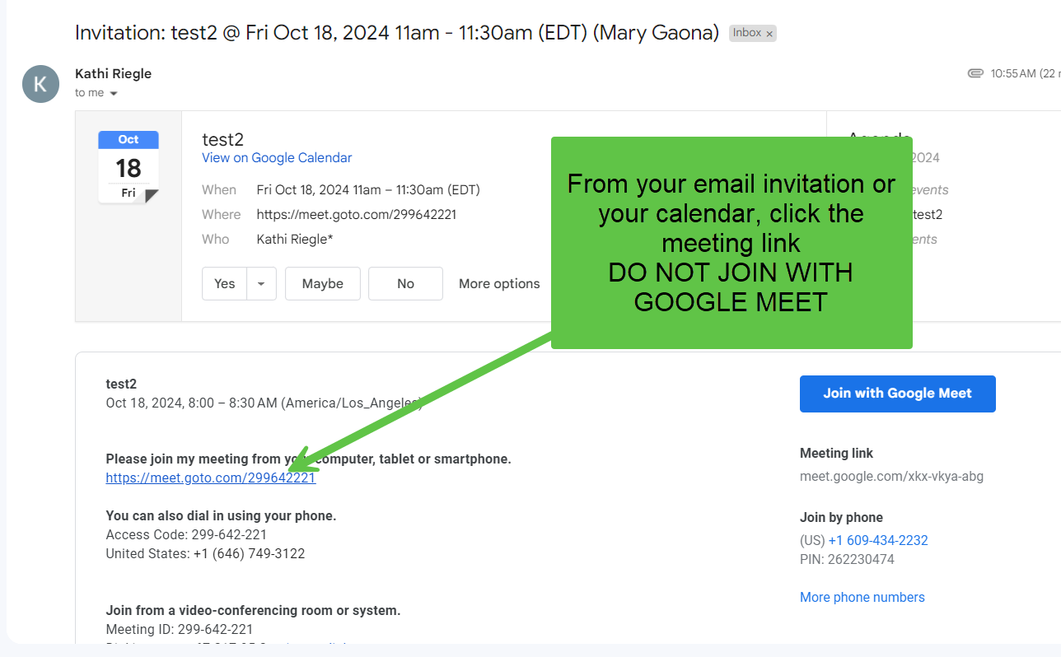
To join a meeting invitation

Slide 14
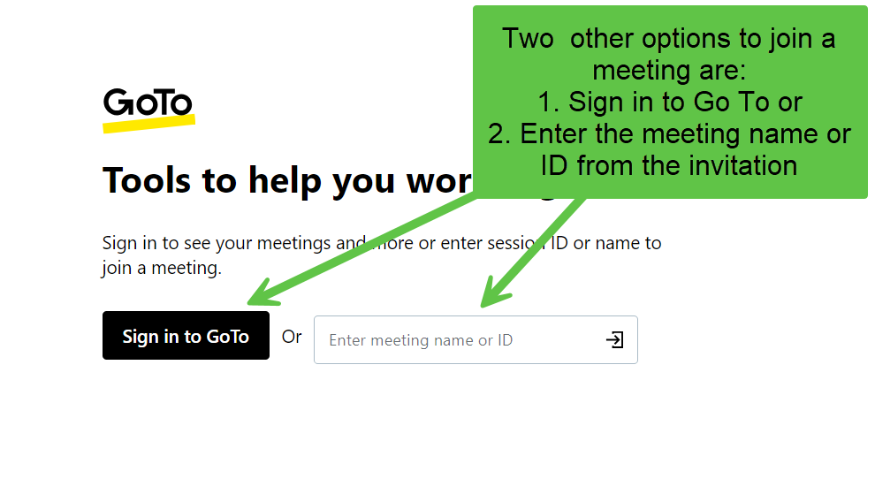
Another way to join

Slide 15
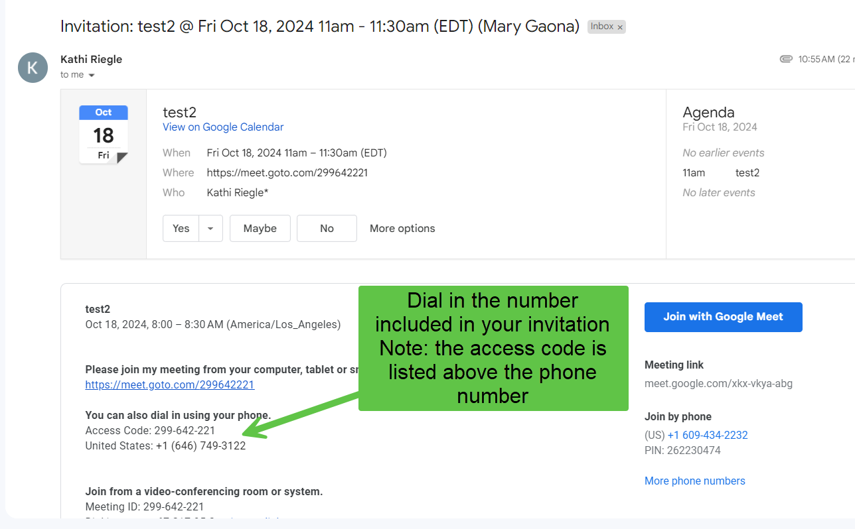
You can also Dial In from your phone, including the black phone on your desk

Slide 16
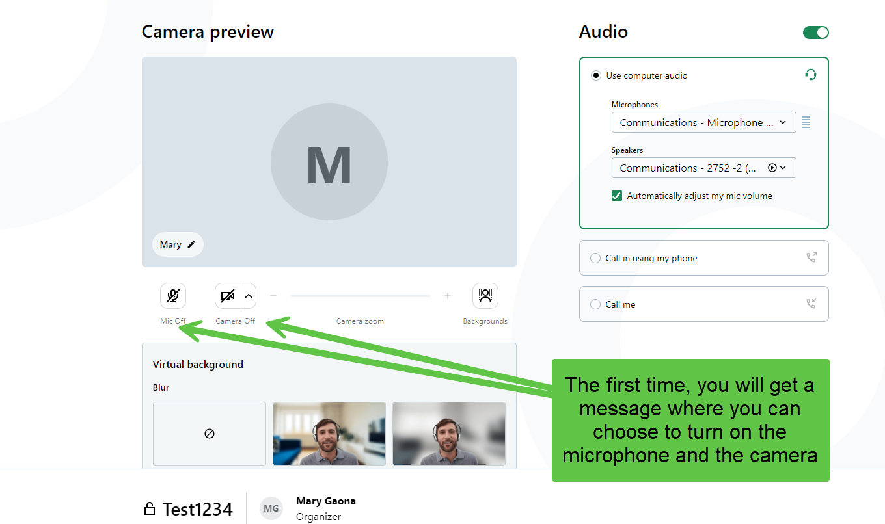
Before start a session

Slide 17
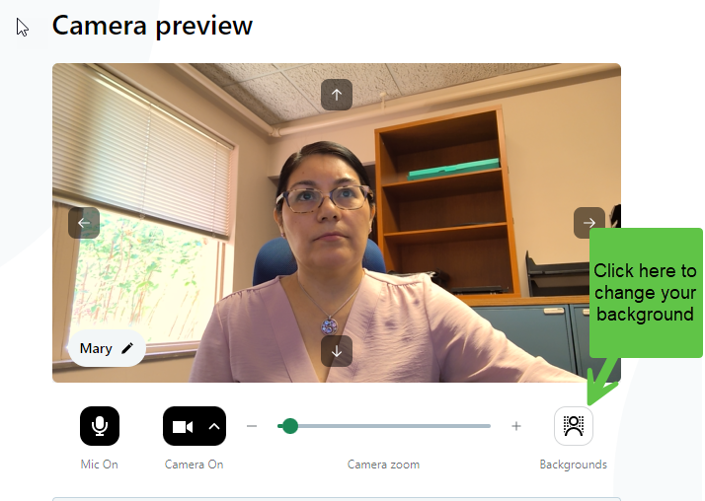
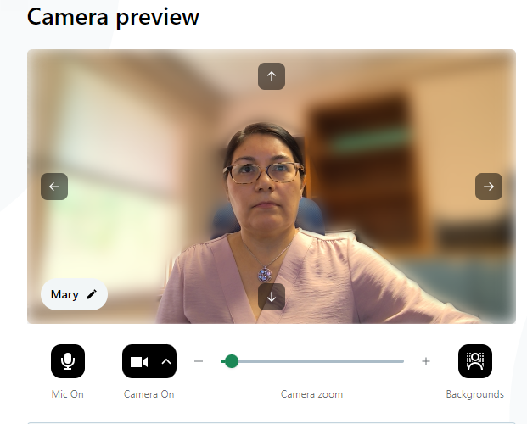
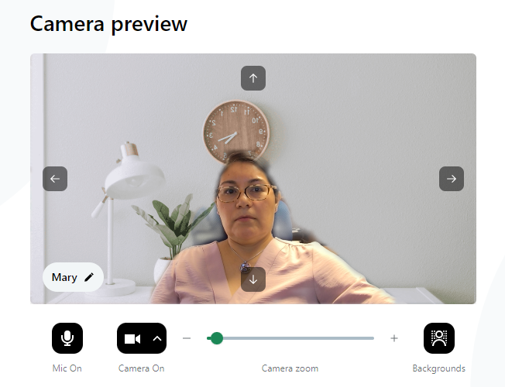
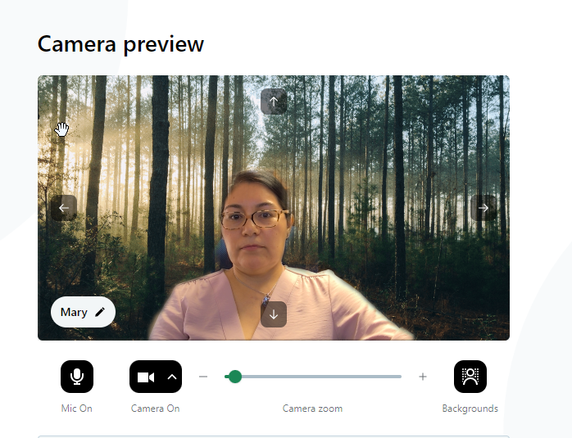
Backgrounds options

Slide 18
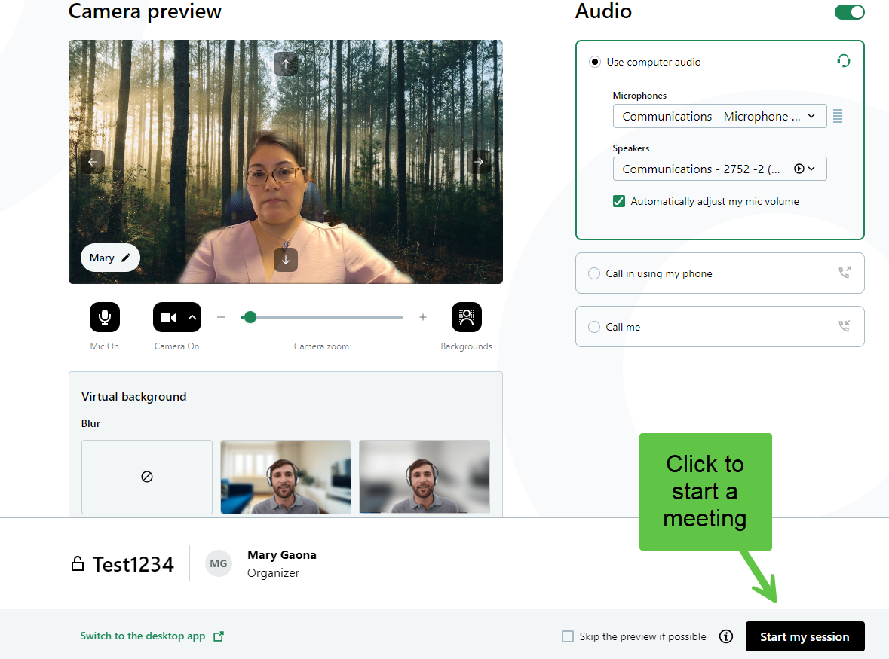

Slide 19
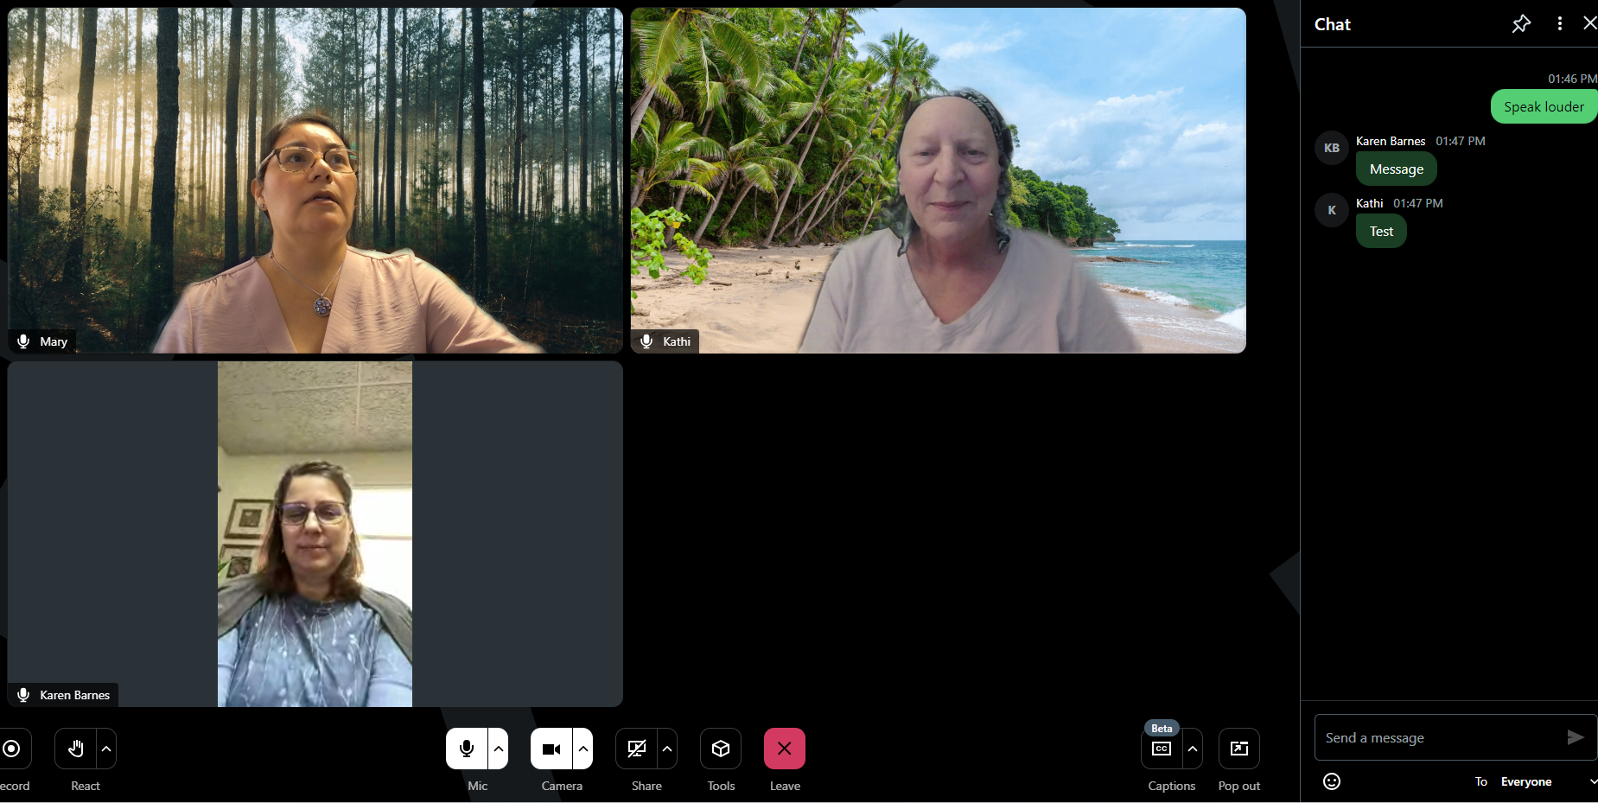

Slide 20
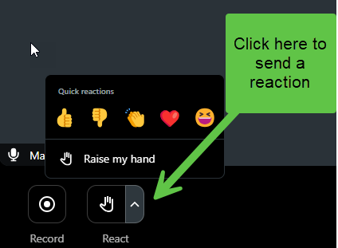
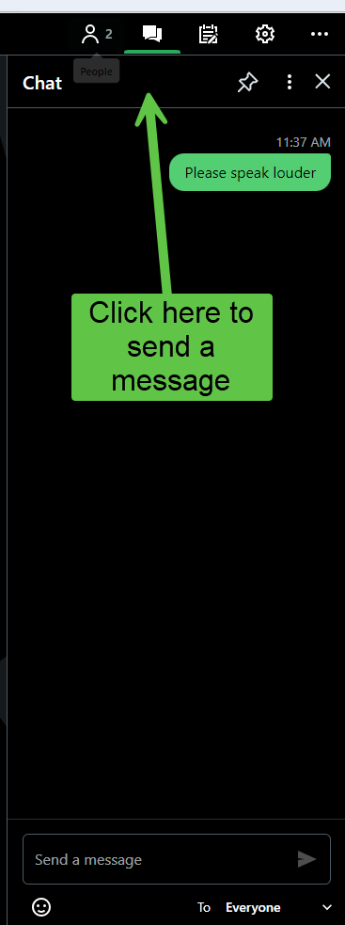
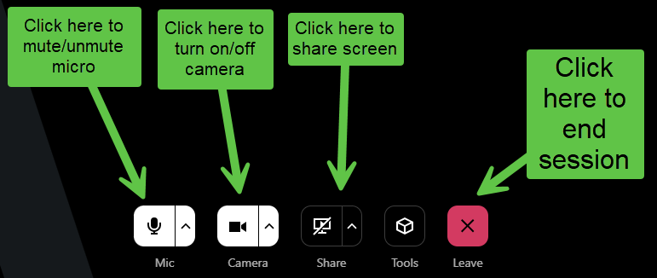

Slide 21
GoTo has multiple GoTo Meeting training resources on YouTube and their website
Online Training Page.
Ctrl + Click to follow link
On this link you can access self-pace courses and join Live Q&A sessions.

Slide 22
Thank you.
Roman Catholic Diocese of Lexington

